Slide 1


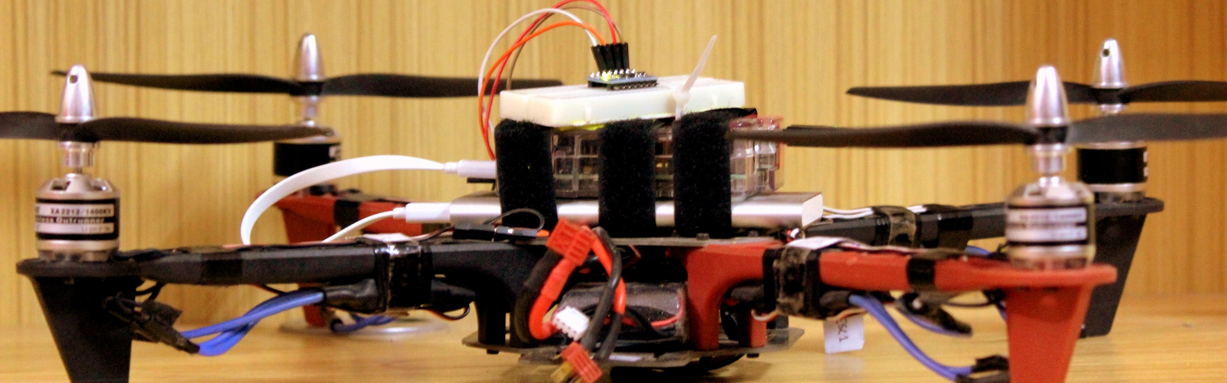
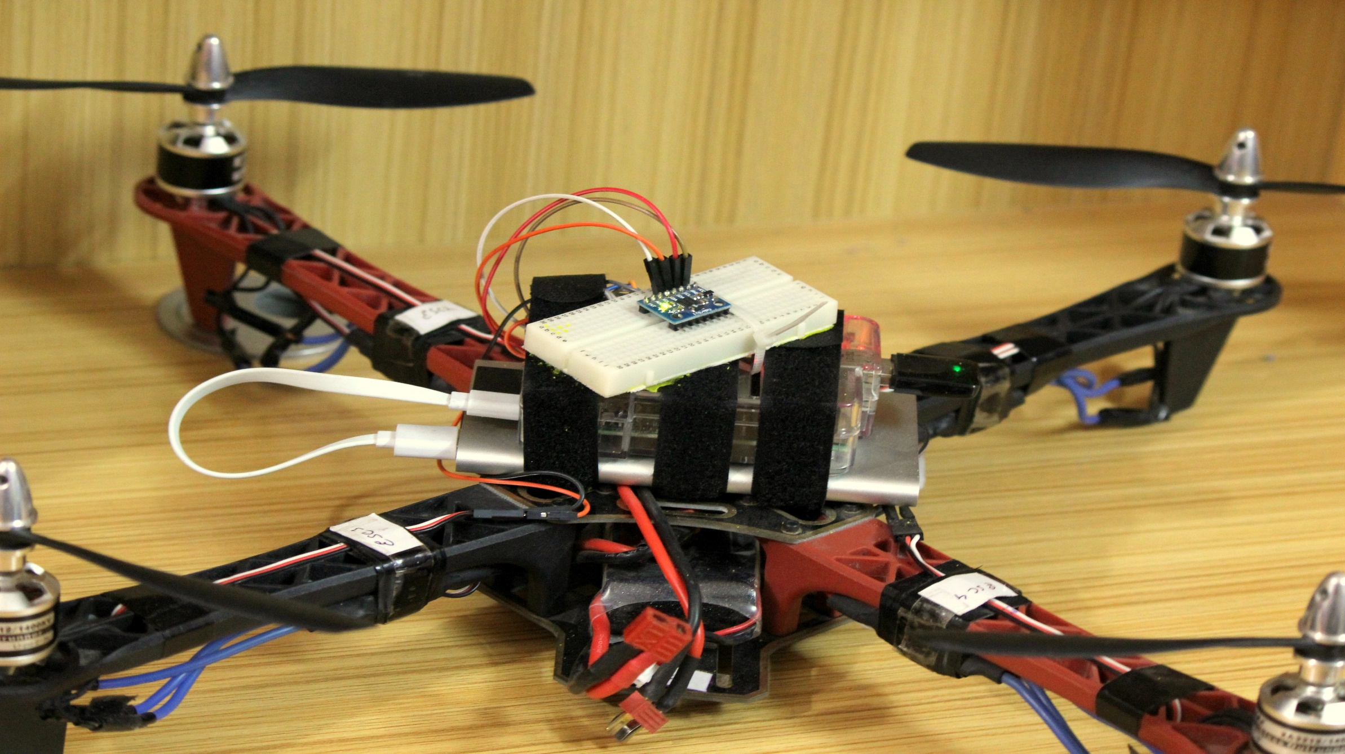
A cost-effective Quad Copter with Raspberry PI
Mohammad Rahber-E-Alam Raafa, Syed Ishtiaque Ahmed Jitu, Md. Ali Zubair
Advisor: Dr. Hasan Uz Zaman
Department of Electrical and Computer Engineering | North South University
ABOUT
Operating Procedure
About
Cost
Cost
Our project aims to investigate the feasibility of a Raspberry Pi to serve as the sole flight controller of a quad copter in order to introduce an affordable and user-friendly platform for quad copter hobbyists.
PRODUCT | UNIT PRICE (BDT) | QUANTITY | TOTAL PRICE (BDT)
Raspberry PI Model B | 3800tk | 1 | 3800tk
Brushless DC Servo Motor 1400KV (920g thrust) | 1300tk | 4 | 5200tk
Mystery Fire Dragon ESC 30Amp | 1200tk | 4 | 4800tk
Propeller (8”x4.5”) | 220tk | 4 | 800tk
LIPO Battery Charger | 3500tk | 1 | 3500tk
DJI f450 Quad copter frame | 1700tk | 1 | 1700tk
Triple Axis Accelerometer and Gyro Breakout - MPU-6050 | 3500tk | 1 | 3500tk
Wild Scorpion 3500mAh LiPo Battery | 2500tk | 1 | 2500tk
Wifi Dongle | 1000tk | 1 | 1000tk
Miscellaneous+ damage replacement cost |  |  | 7000tk
Total |  |  | 33800tk
Step 1
Turn on the hotspot on your smartphone. Power on the raspberry Pi.
Turn on the LIPO battery connected to the ESCs.
Wait for the hotspot to detect the raspberry Pi.
Step 2
Launch the App. Enter suitable values for PID Tuning.
Press Start.
Wait for the beeping noise from all the ESCs to confirm calibration.
Step 3
Move over to the Control Interface to control the quad copter.
Step 4
Move over to the PID interface and press shutdown once the quad is back on the ground.
Motivation
In recent years, more than a million UAVs (Unmanned Aerial Vehicles) have been sold, and new potential uses are dreamed up seemingly by the day. Traditional quad copters use an expensive dedicated flight controller, such as Ardu-Pilot, that comes with a bulky RC remote, making it complicated for enthusiastic beginners to grasp the technique of operating these machines. Moreover, in third world countries like Bangladesh, high cost of these UAVs play a vital role in satisfying the enthusiasm of increasing quad copter hobbyists. Therefore, the main objective of our project is to implement a cheaper design of a quad copter using a raspberry Pi as the sole flight controller and developing a free android app to introduce a simpler, user-friendly interface to control the quad copter.
Setup
Results
Project Overview
The whole setup weighs approximately 1kg.
The raspberry Pi shows zero latency when signal is sent within 30-40 meters. (Can vary depending on the range of the hotspot and WIFI dongle).
Electronic Speed Controllers has been calibrated to receive a PWM signal of minimum 700us and maximum of 2000us.
Real-time processing made possible without the implementation of real-time kernel.
Sensor readings processed at 450Hz to update the ESCs
3500mAh LIPO Battery supports backup up to 30minutes.
The quad lifts off at 40% throttle (i.e when a PWM signal of 1050us is sent to the motors).
Android app has been developed to send control signals to the raspberry Pi through a static IP.
Due to incorrect PID tuning, the quad copter is currently unstable. Further flight testing is required to confirm stability.
The raspberry Pi Model B Rev.2 has been used to serve as the sole flight controller for the quad copter.
Raspberry PI has been given a static IP address to allow remote access over Secure Shell, or SSH, which is a cryptographic (encrypted) network protocol to allow remote login.
6DOF MPU6050 (Triple Axis Gyro and Accelerometer) interfaced with raspberry PI over I2C communication protocol to maintain the orientation of the quad copter.
Using simple C programming, we have implemented a cascaded PID (Proportional-Integral-Derivative) loop, where Stabilize PID sits on top of Rate PID. In Rate mode, the user has to have control of the quad at all times to keep it stable. More experienced flyers usually prefer Rate Mode over Stabilize Mode. In Stabilize Mode, the user inputs the angle that quad should hold. If the user lets go of the control, the quad auto-levels itself.
Android App developed to allow the user to tune both Rate PID and Stabilize PID in real-time, as well as control the quad copter through WIFI.
Future work includes finer PID tuning for stable flight, and interfacing the Raspberry PI with a webcam to view live streaming video on the android app during flight.
Conclusion
Based on the findings, the raspberry Pi can be an excellent platform for handling computations necessary for quad copter flight.
It has proved to receive control signal and produce desired output all in real-time, without the implementation of any real-time kernel.
Raspberry Pi, interfaced with the android app, does come as a cheaper and simpler package that the users can easily get used to.
Android App Interface
Rate PID Tuning
Helps the user decide how fast the quad will rotate, based on gyro reading.
Stabilize PID Tuning
Helps the user tune the stability of the quad by combining data from gyro and accelerometer.
User Control Interface
Once tuning is done, the quad can be controlled with this simple interface.
References
Acknowledgement
A Guide To Using IMU (Accelerometer and Gyroscope Devices) in Embedded Applications. (n.d.).Retrieved 2014, from http://www.starlino.com/imu_guide.html
Gareth O. URL: https://ghowen.me/build-your-own-Quad copter-autopilot/
P. Castillo, R. Lozano, and A. Dzul, “Stabilistaion of a mini rotorcraft with four rotors,” IEEE Control SystemsMagazine, pp. 44-55, Dec. 2005
Ghirst R. URL: https://github.com/richardghirst/PiBits/tree/master/ServoBlaster. Jan. 2014
The completion of this undertaking would not have been successful without the participation and assistance of so many people whose names may not all be enumerated. However, the group would like to express their deep appreciation and indebtedness particularly to our respected project supervisor, Dr. Hasan Uz Zaman for his endless support, kind and understanding spirit through the numerous ups and downs this project has seen.

